Slide 1
Introduction to DevOps with Azure DevOps Pipelines

Slide 2
”Any development process requires a reliable means of build and delivery, ‘DevOps’ in the modern terminology.”
In this session we will look at…
What is DevOps?
Why DevOps is important?
The key factors in successful adoption
How Azure DevOps can help in this process.

Slide 3
What is DevOps?
People. Process. Products.
Build& Test
Deploy
DevOps is the union of people, process, and products to enable continuous delivery of value to your end users.
“
Continuous Delivery
Develop
Operate
”
Plan & Track
Monitor & Learn
Donovan Brown
Senior DevOps Program Manager on Microsoft's US Developer Division team
Notes:
DevOps is the union of people, process and products to enable the continuous delivery of value to your end customers

Slide 4


High Performance DevOps Companies Achieve…
46x Deployment
Frequency
2,555x Faster Lead
Time For Changes
Faster
Time to Market
DevOps
$
Increased
Revenue
7x Lower Change
Failure Rate
2,604x Faster Mean
Time to Recover

Slide 5
What technologies do I need to support DevOps?
DevOps brings together people, processes, and technology, automating software delivery to provide continuous value to your users.
Continuous Integration (CI)
Improve software development quality and speed.
When you use Azure Pipelines or Jenkins to build apps in the cloud and deploy to Azure, each time you commit code, it’s automatically built and tested and bugs are detected faster.
Continuous Deployment (CD)
By combining continuous integration and infrastructure as code (IaC), you’ll achieve identical deployments and the confidence to deploy to production at any time.
With continuous deployment, you can automate the entire process from code commit to production if your CI/CD tests are successful.
Continuous Learning & Monitoring
With Azure Application Insights you can identify how your applications are performing and test if the recent deployment made things better or worse.
Using CI/CD practices, paired with monitoring tools, you’ll be able to safely deliver features to your customers as soon as they’re ready.

Slide 6





Introducing Azure DevOps
Azure Boards
Azure Pipelines
Azure Repos
Deliver value to your users faster using proven agile tools to plan, track, and discuss work across your teams.
Build, test, and deploy with CI/CD that works with any language, platform, and cloud. Connect to GitHub or any other Git provider and deploy continuously.
Get unlimited, cloud-hosted private Git repos and collaborate to build better code with pull requests and advanced file management.
Azure Test Plans
Azure Artifacts
➔
https://azure.com/devops
Test and ship with confidence using manual and exploratory testing tools.
Create, host, and share packages with your team, and add artifacts to your CI/CD pipelines with a single click.
Notes:
So does TFS

Slide 7

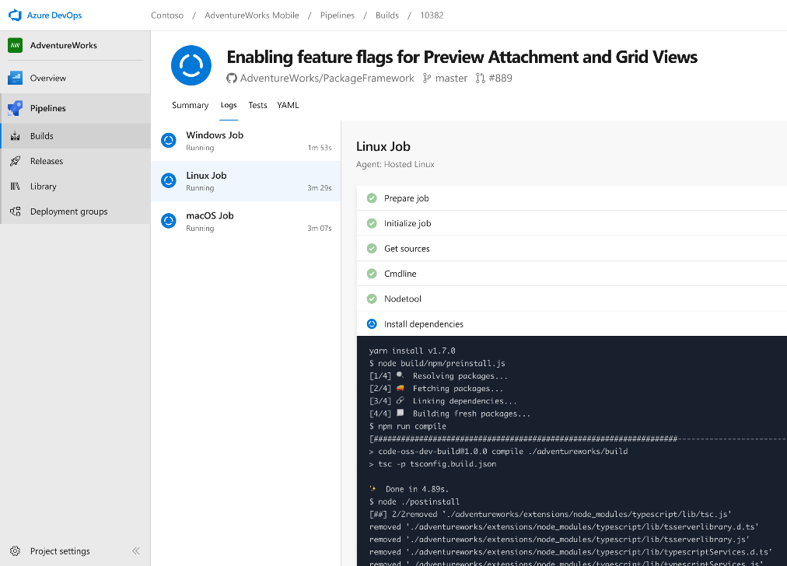


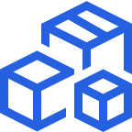

Azure Pipelines
Cloud-hosted pipelines for Linux, Windows and macOS, with unlimited minutes for open source
Any language, any platform, any cloud
Build, test, and deploy Node.js, Python, Java, PHP, Ruby, C/C++, .NET, Android, and iOS apps. Run in parallel on Linux, macOS, and Windows. Deploy to Azure, AWS, GCP or on-premises
Extensible
Explore and implement a wide range of community-built build, test, and deployment tasks, along with hundreds of extensions from Slack to SonarCloud. Support for YAML, reporting and more
Containers and Kubernetes
Easily build and push images to container registries like Docker Hub and Azure Container Registry. Deploy containers to individual hosts or Kubernetes.
Best-in-class for open source
Ensure fast continuous integration/continuous delivery (CI/CD) pipelines for every open source project. Get unlimited build minutes for all open source projects with up to 10 free parallel jobs across Linux, macOS and Windows
Notes:
Azure Pipelines is the perfect launchpad for your code – automating your builds and deployments so you spend less time with the nuts and bolts and more time being creative

Slide 8


Azure Pipelines
Microsoft Open Source
Free unlimited build minutes for public projects
Up to 10 free parallel jobs across Windows, Linux and macOS
Notes:
All the builds you need, using the power of Azure you get one service that gives you unlimited build minutes where you can build on Windows Mac and Linux in parallel using a single build YAML file.

Slide 9

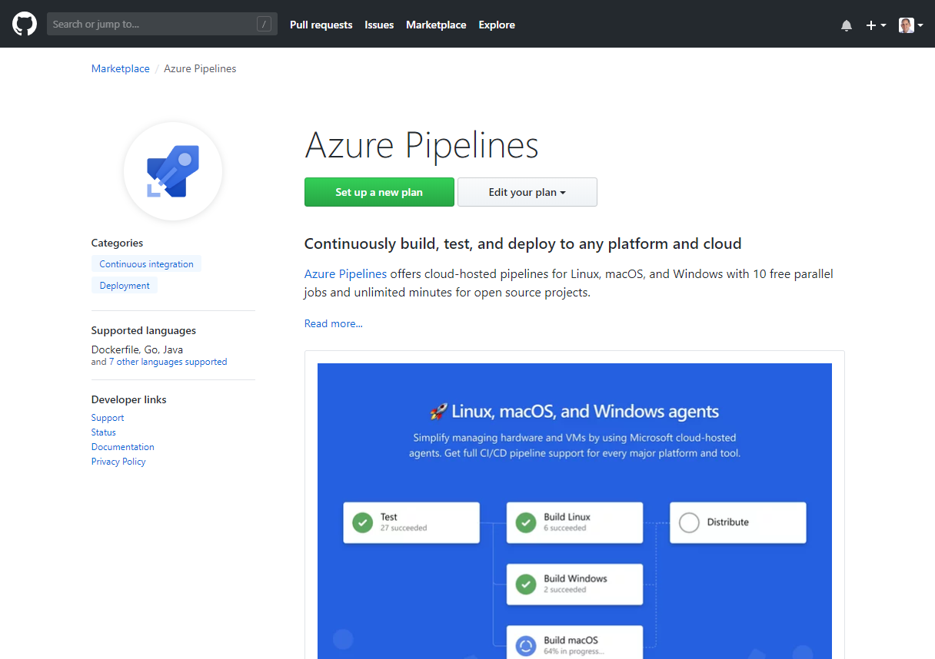
Integrated with GitHub
Azure Pipelines available now to any developer from the GitHub Marketplace

Slide 10
Summary
Azure DevOps Pipelines are
Any Platform
Any Language
Can help provide a robust DevOps build and release model
Free for OSS projects
Azure DevOps https://azure.com/devops
All the slides, code can be found on https://github.com/rfennell
CI/CD is via public projects on https://dev.azure.com/richardfennell

